Slide 1
Everything in Valueflows is connected.
Notes:
See subsequent slides for technical connection requirements.

Slide 2
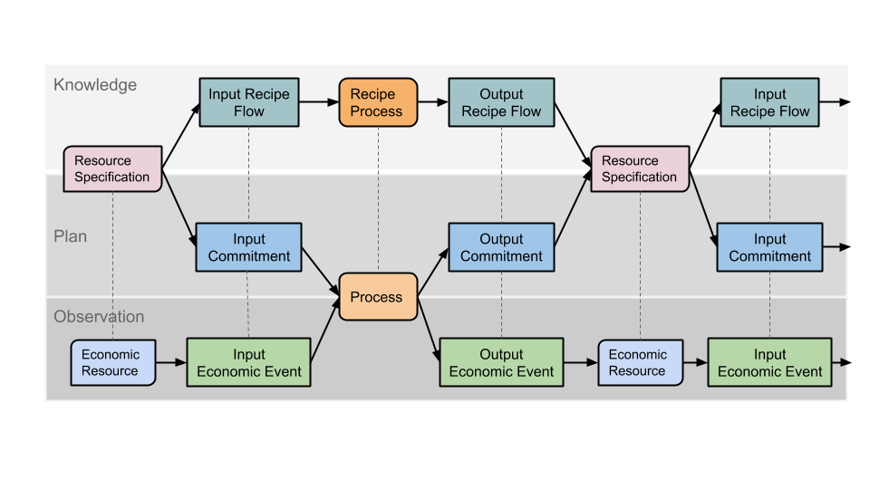
VF has 3 levels...and they are connected like so
The Plan level depends on Recipes and prepares for Actuals.

Slide 3
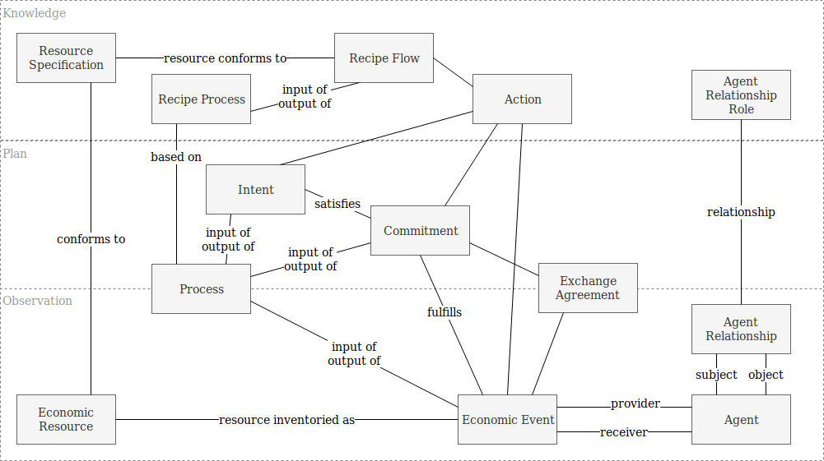
In VF, you are an Economic Agent.

Slide 4
You may be connected to other Agents by means of Agent Relationships.
Notes:
An Agent needs to be able to access their Relationships, and the Relationships need to be able to access their Roles.

Slide 5
You are connected to all of the Economic Events you have participated in.
They may be many types of Events: Work, Production, Consumption, etc.
Notes:
An Agent needs to be able to access all of the Economic Events they participated in, and an Economic Event needs to be able to access its provider and receiver Agents.

Slide 6
Economic Events change Economic Resources.
They may create, consume, use, cite, provide, or transfer Resources.
Notes:
An Economic Resource needs to be able to access all of the Economic Events that affect it, and an Economic Event needs to be able to access the resource it affects.

Slide 7
You may own or have custody or have some other responsibility
for Economic Resources
Notes:
Likewise an Agent will need to be able to access all the Resources for which it has some responsibility, and a Resource needs to be able to access the Agents who are responsible for it. This might be via Economic Events or direct connections.

Slide 8
Economic Events may be connected to Processes.
They may be inputs to, or outputs from, Processes.
Notes:
A Process needs to be able to access all of the Economic Events that are connected to it, and an Economic Event needs to be able to access a Process that it may be (optionally) connected to as an input or output.

Slide 9
If the same Resource is an output from one Process and then an input to another Process, then those Processes are connected by a resource flow.
Notes:
Traversals need to be able to follow connections from one Process to another where the same Resource flows out of one Process and into another.

Slide 10
Economic Events may also Transfer Resources from one Agent to another,
which can be part of Exchanges.
Notes:
Economic Events need to be able to access Exchange Agreements to which they may (optionally) be connected, and Exchange Agreements need to be able to access all of their connected Economic Events.

Slide 11
If the same Resource is transferred in an Exchange and then becomes an input to a Process, then the Exchange and the Process are connected.
Notes:
Traversals need to be able follow connections between Processes and Exchange Agreements that are connected by Resource flows.

Slide 12
Likewise if the same Resource is an output from a Process
and then transferred in an Exchange.

Slide 13
And likewise if the same Resource is transferred in one Exchange and then transferred again in another.
Notes:
Traversals also need to be able to follow Resource flow connections between Exchanges.

Slide 14
Processes and Exchanges may be planned
by means of Commitments.
Notes:
Processes and Exchange Agreements need to be able to access their planned Commitments, and Commitments need to be able to access their connected Processes and Exchange Agreements.

Slide 15
Commitments are plans for Economic Events
that have not happened yet.
Notes:
Economic Events need to be able to access Commitments that they fulfill, and Commitments need to be able to access Economic Events that fulfill them.
Not specified in those diagram: Agents need to be able to access Commitments and Intents that they are involved in.

Slide 16
All of the lines connecting the Knowledge concepts to each other, and to the Plan and Observation concepts, also require mutual accessibility.

Slide 17
Value Flows - forward and backward
Resource
Input
Event
Process
Output
Event
Resource
Input
Event
Resource
Input
Event
Process
Output
Event
Resource
Process
Output
Event
Resource
Input
Event
Resource
Input
Event
Product
Collaboration
Reputation
Income

Slide 18
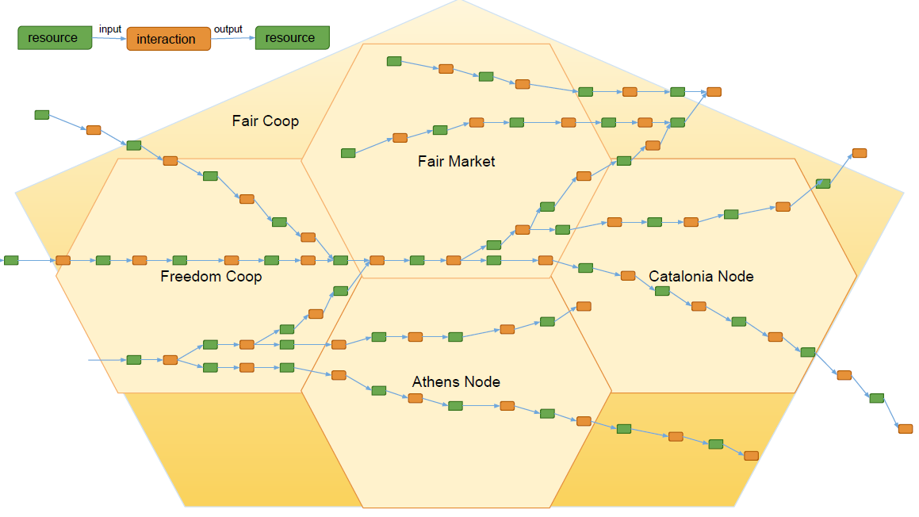
These flows can connect everywhere, in any open app

Slide 19
The end

